Slide 1
IBM University Engagement Project Submission
“Exploring the Power of Agentic AI with IBM Granite and LangFlow”

Slide 2

Project Tile – Fitness Buddy
Domain of Project - Healthcare
Student Name | Recent Passport Photo | Email ID | Mobile number [WhatsApp]
SHOHOM CHAKRABORTY |  | shohom2005@gmail.com | +91 9862530321

Slide 3
Problem Statement 13 – Fitness Buddy
Problem Statement :
The challenge - In today’s fast-paced world, many individuals struggle to maintain a healthy lifestyle due to lack of personalized guidance, time constraints, and inconsistent motivation. Traditional fitness solutions often require expensive subscriptions, in-person consultations, or rigid schedules that don't adapt to personal preferences or daily routines. There is a growing need for an accessible, friendly, and intelligent virtual assistant that can provide on demand fitness advice, healthy lifestyle suggestions, and basic nutrition guidance—all tailored to individual needs and available at any time.
Fitness Buddy aims to solve this problem by offering a conversational, AI-powered health and fitness coach that can:
Recommend home workouts and routines based on user input.
• Provide motivational tips and daily fitness inspiration.
• Suggest simple, nutritious meal ideas.
• Encourage habit-building and consistency.

Slide 4
Proposed Solution - Fitness Buddy
Conversational AI Coach — Chat interface powered by IBM Granite for instant, personalized fitness advice.
Personalized User Profile — Sidebar captures fitness goal, level, equipment, workout days, age group, and diet; every AI response is conditioned on this.
Home Workout Recommendations — Structured plans (warm-up → circuit → cool-down) requiring no gym.
Nutritious Meal Suggestions - Breakfast, lunch, and dinner ideas respecting dietary preferences.
Daily Motivation & Habit Building — Tips, quotes, and actionable consistency strategies.
Free, Zero-Barrier Access — Built on IBM Cloud Lite , accessible from any browser.
Multi-Turn Conversation Memory — Retains last 8 exchanges for contextual follow-up.

Slide 5
Technology Used
IBM Granite 4H Small: Foundation LLM for all AI-generated responses
IBM watsonx.ai (Lite)IBM Cloud service hosting and invoking the model
ibm-watsonx-ai SDK v1.9Python SDK — Model Inference + Chat API
Python 3.14Core application language
Streamlit 1.56Web UI framework — chat, sidebar, buttons
python-dotenvSecure loading of API keys from .env
Chat API (OpenAI-style)/ml/v1/text/chat with system/user/assistant message roles
IBM Cloud – It provides the infrastructure to build, deploy, and scale the Nutrition Agent efficiently. IBM Cloud enables a reliable, secure, and scalable environment for deploying the Nutrition Agent.
RAG– RAG to fetch real data first, then generate intelligent answers, making the Nutrition Agent more trustworthy and effective.
Vector Database (FAISS/Chroma) – For RAG-based nutritional data retrieval

Slide 6
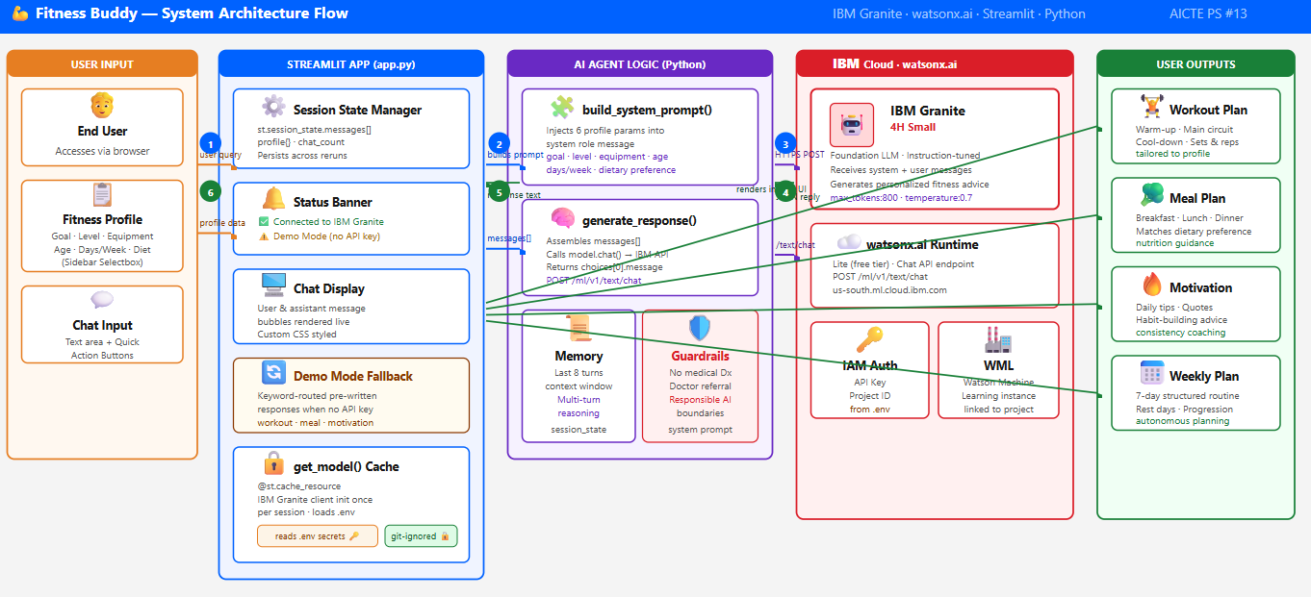
Architecture blueprint

Slide 7
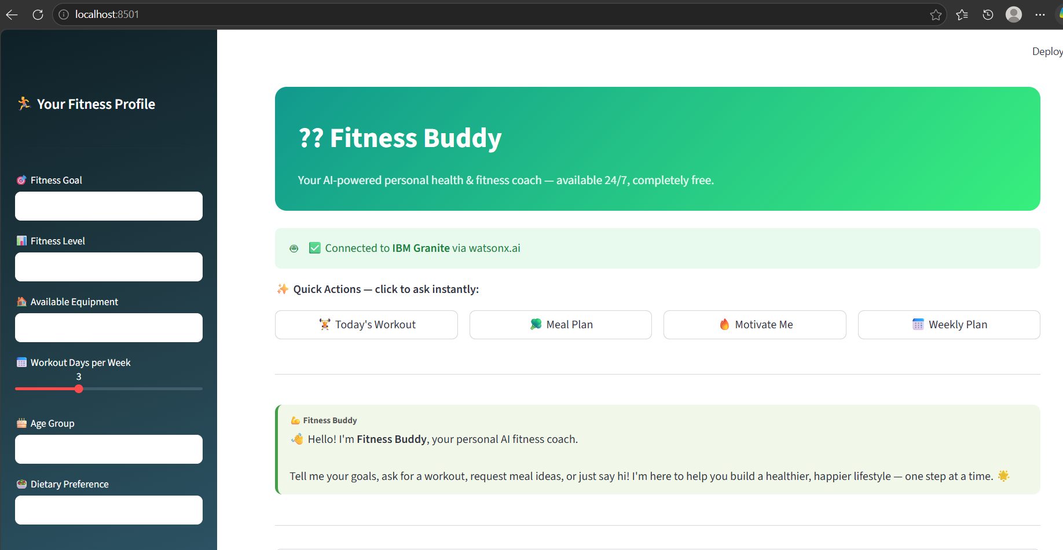
PROJECT SCREENSHOTS

Slide 8
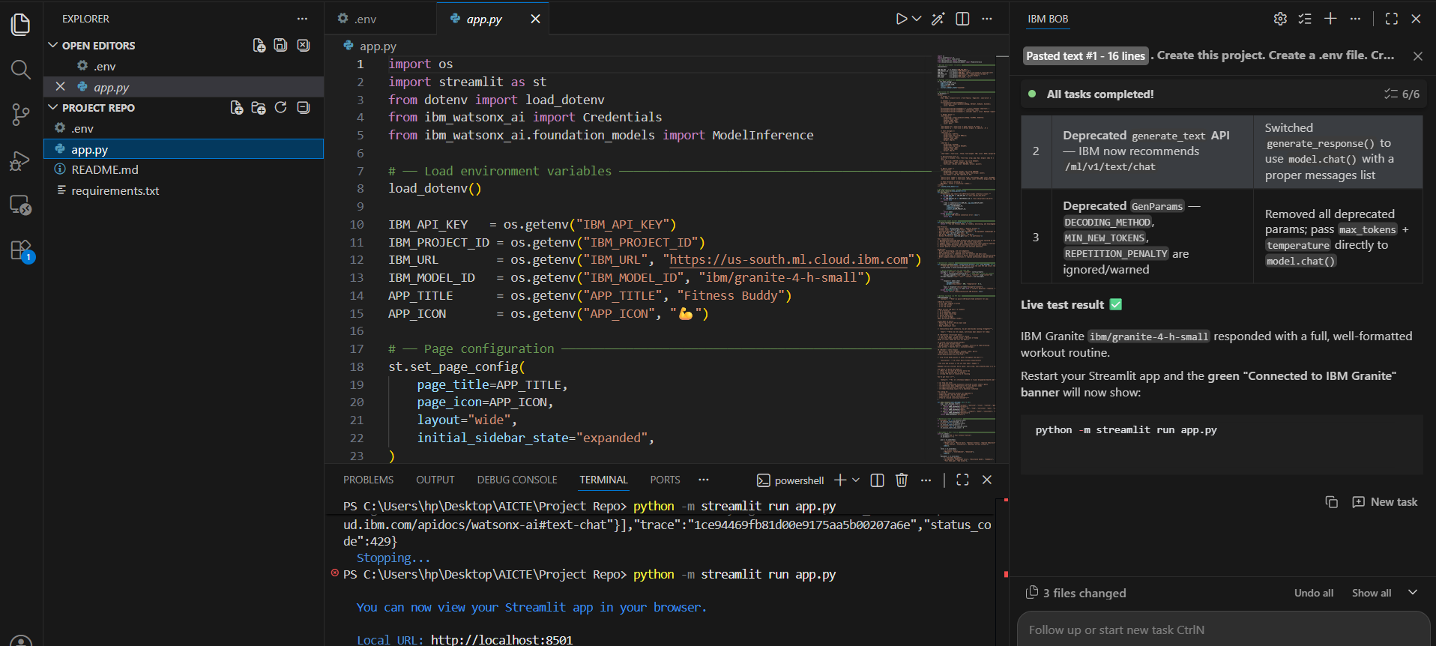

Slide 9

Role of Agentic AI in the solution
Role of Agentic AI in Fitness Buddy
Agentic AI means the system can perceive → reason → plan → act
Goal-Directed Behavior — The AI autonomously aligns every response toward the user's declared without being reminded each turn.
Context Awareness — The full profile is injected into the IBM Granite system prompt, so the model reasons about constraints.
Multi-Turn Reasoning — A rolling 8-message conversation window lets the agent build on prior advice, handle follow-ups, and refine recommendations coherently.
Responsible Decision-Making — The system prompt enforces safety guardrails: no medical diagnosis, always recommend a doctor, stay in coaching role.

Slide 10
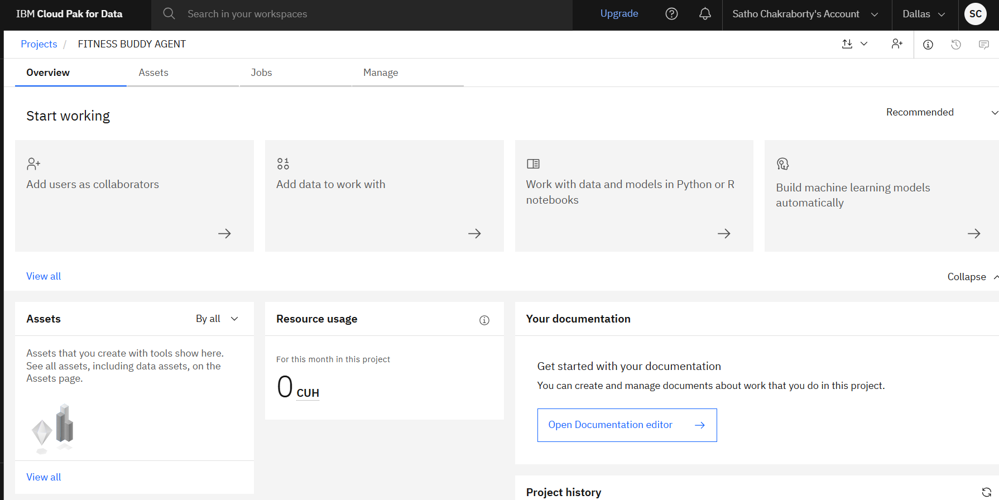
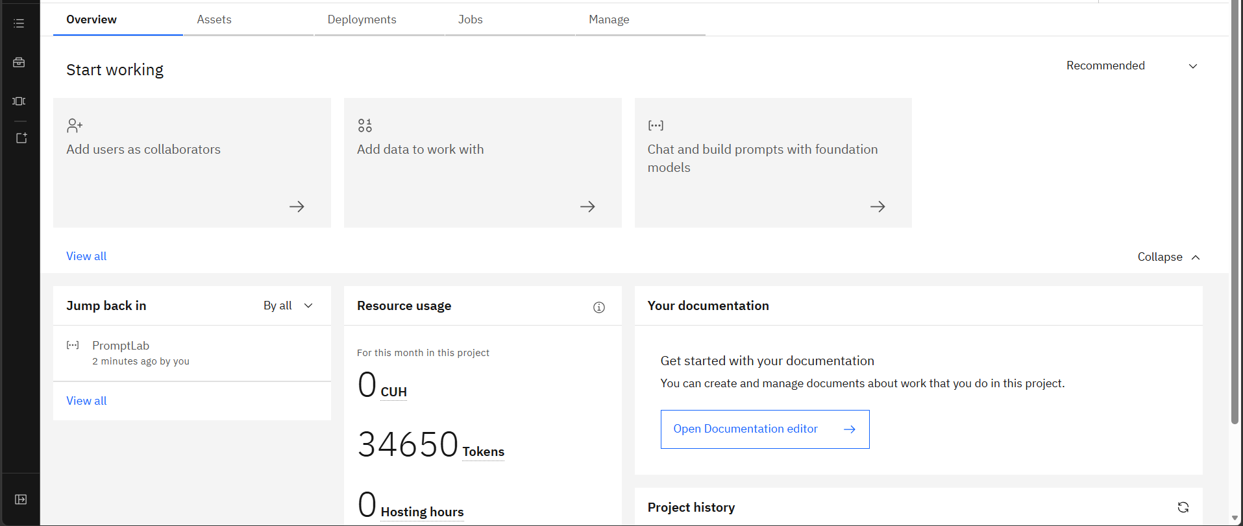
Token Usage
34650 token are used
Before Prompt
After the Prompt
·
·
·

Slide 11
Novelty and Uniqueness
The proposed Nutrition Agent stands out by combining Agentic AI and personalization into a single intelligent system.
IBM Granite as the Fitness Core — Enterprise-grade responsible AI, not a generic LLM.
Profile-Conditioned System Prompting — 6 user parameters dynamically injected per API call.
Zero-Cost AI Coaching — Runs entirely on IBM Cloud Lite + Streamlit.
Demo Mode Resilience — Fully functional without API credentials for demos/presentations.
Multi-Domain in One Thread — Exercise, nutrition, and habit psychology — all in one conversation.
Ethical AI Guardrails — Responsible boundaries baked into the agent's behavior by design.

Slide 12
Git Hub Link
GITHUB LINK:
https://github.com/Humso215/AICTE-Internship-Repo
·
·
·

Slide 13
Future Scope
Full Agentic Tool Use — IBM Granite autonomously searches workout videos, fetches food data, and schedules calendar reminders.
Community Challenges & Social Features — Peer challenges, leaderboards, and group workout plans for community motivation.
Multi-Language Support — Serve users in Hindi, Tamil, Spanish, French, and other languages using IBM Granite's multilingual capabilities.
Tele-health & Doctor Referral Integration — When health concerns exceed the AI's scope, automatically connect users with verified healthcare professionals.
Wearable Device Integration — Connect smartwatches/fitness bands to feed heart rate, steps, and sleep data directly into the AI profile.
Computer Vision for Form Correction — Use device camera + pose estimation to detect exercise form and give real-time corrective feedback.
·
·
·

Slide 14
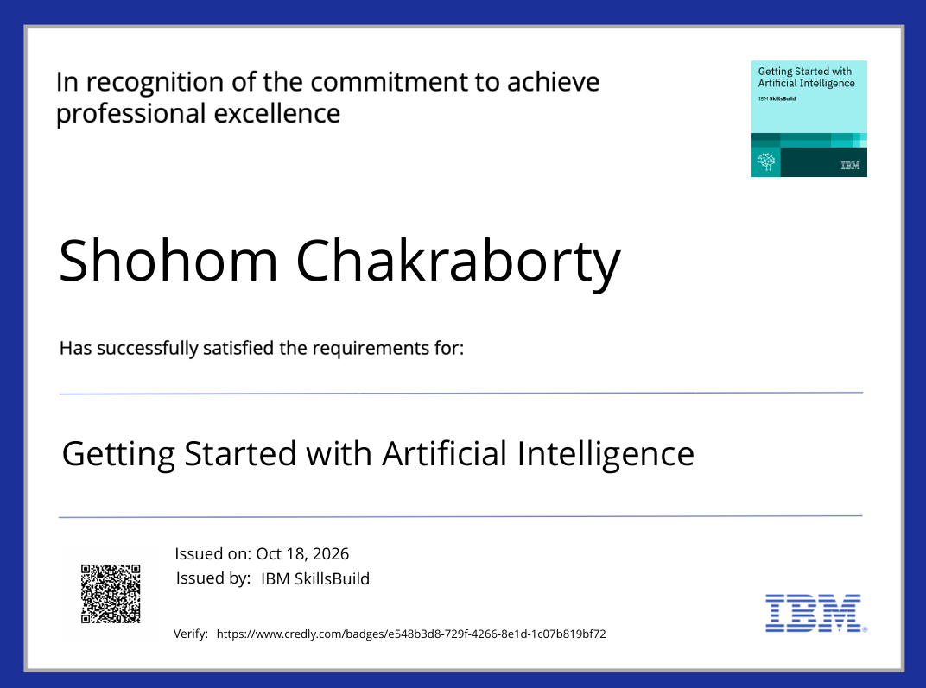
Certificates Earned:

Slide 15


Slide 16
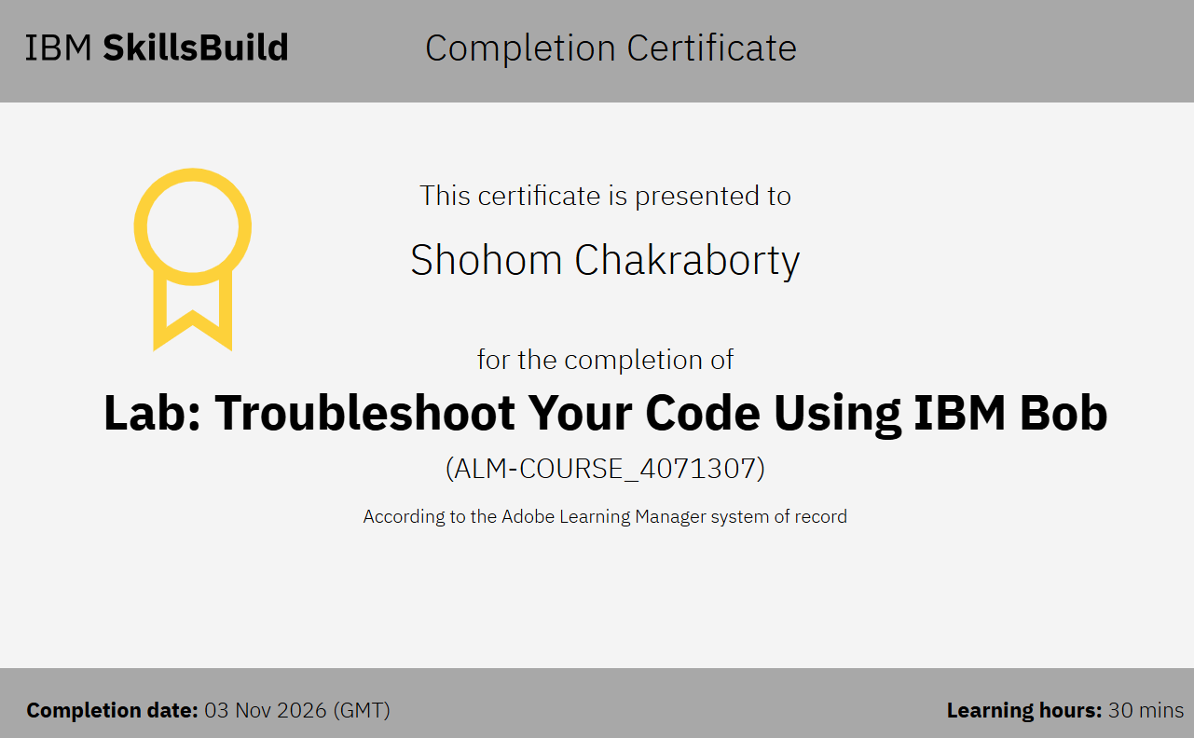
Certificates Earned:​

Slide 17


